Slide 1
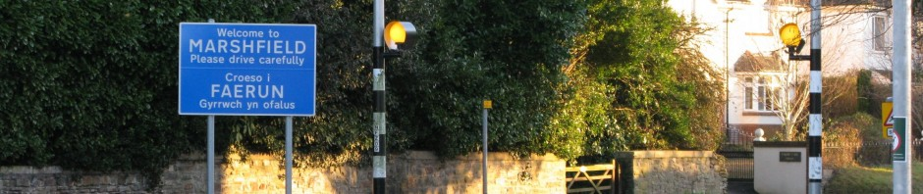
Marshfield Community Council
Public Consultation Meeting
Leisure Facilities and Community Needs
27th September, 2012
Bringing our Community Together

Slide 2
Welcome!
Introduce the Community Council
Explain how we operate, our aims and priorities
Share plans for leisure facilities
Open forum
  Listen to your feedback and ideas on leisure facilities and a range of community issues
Use this feedback to refine our activities and priorities
Notes:
Consultation set before gypsy issue.

Slide 3
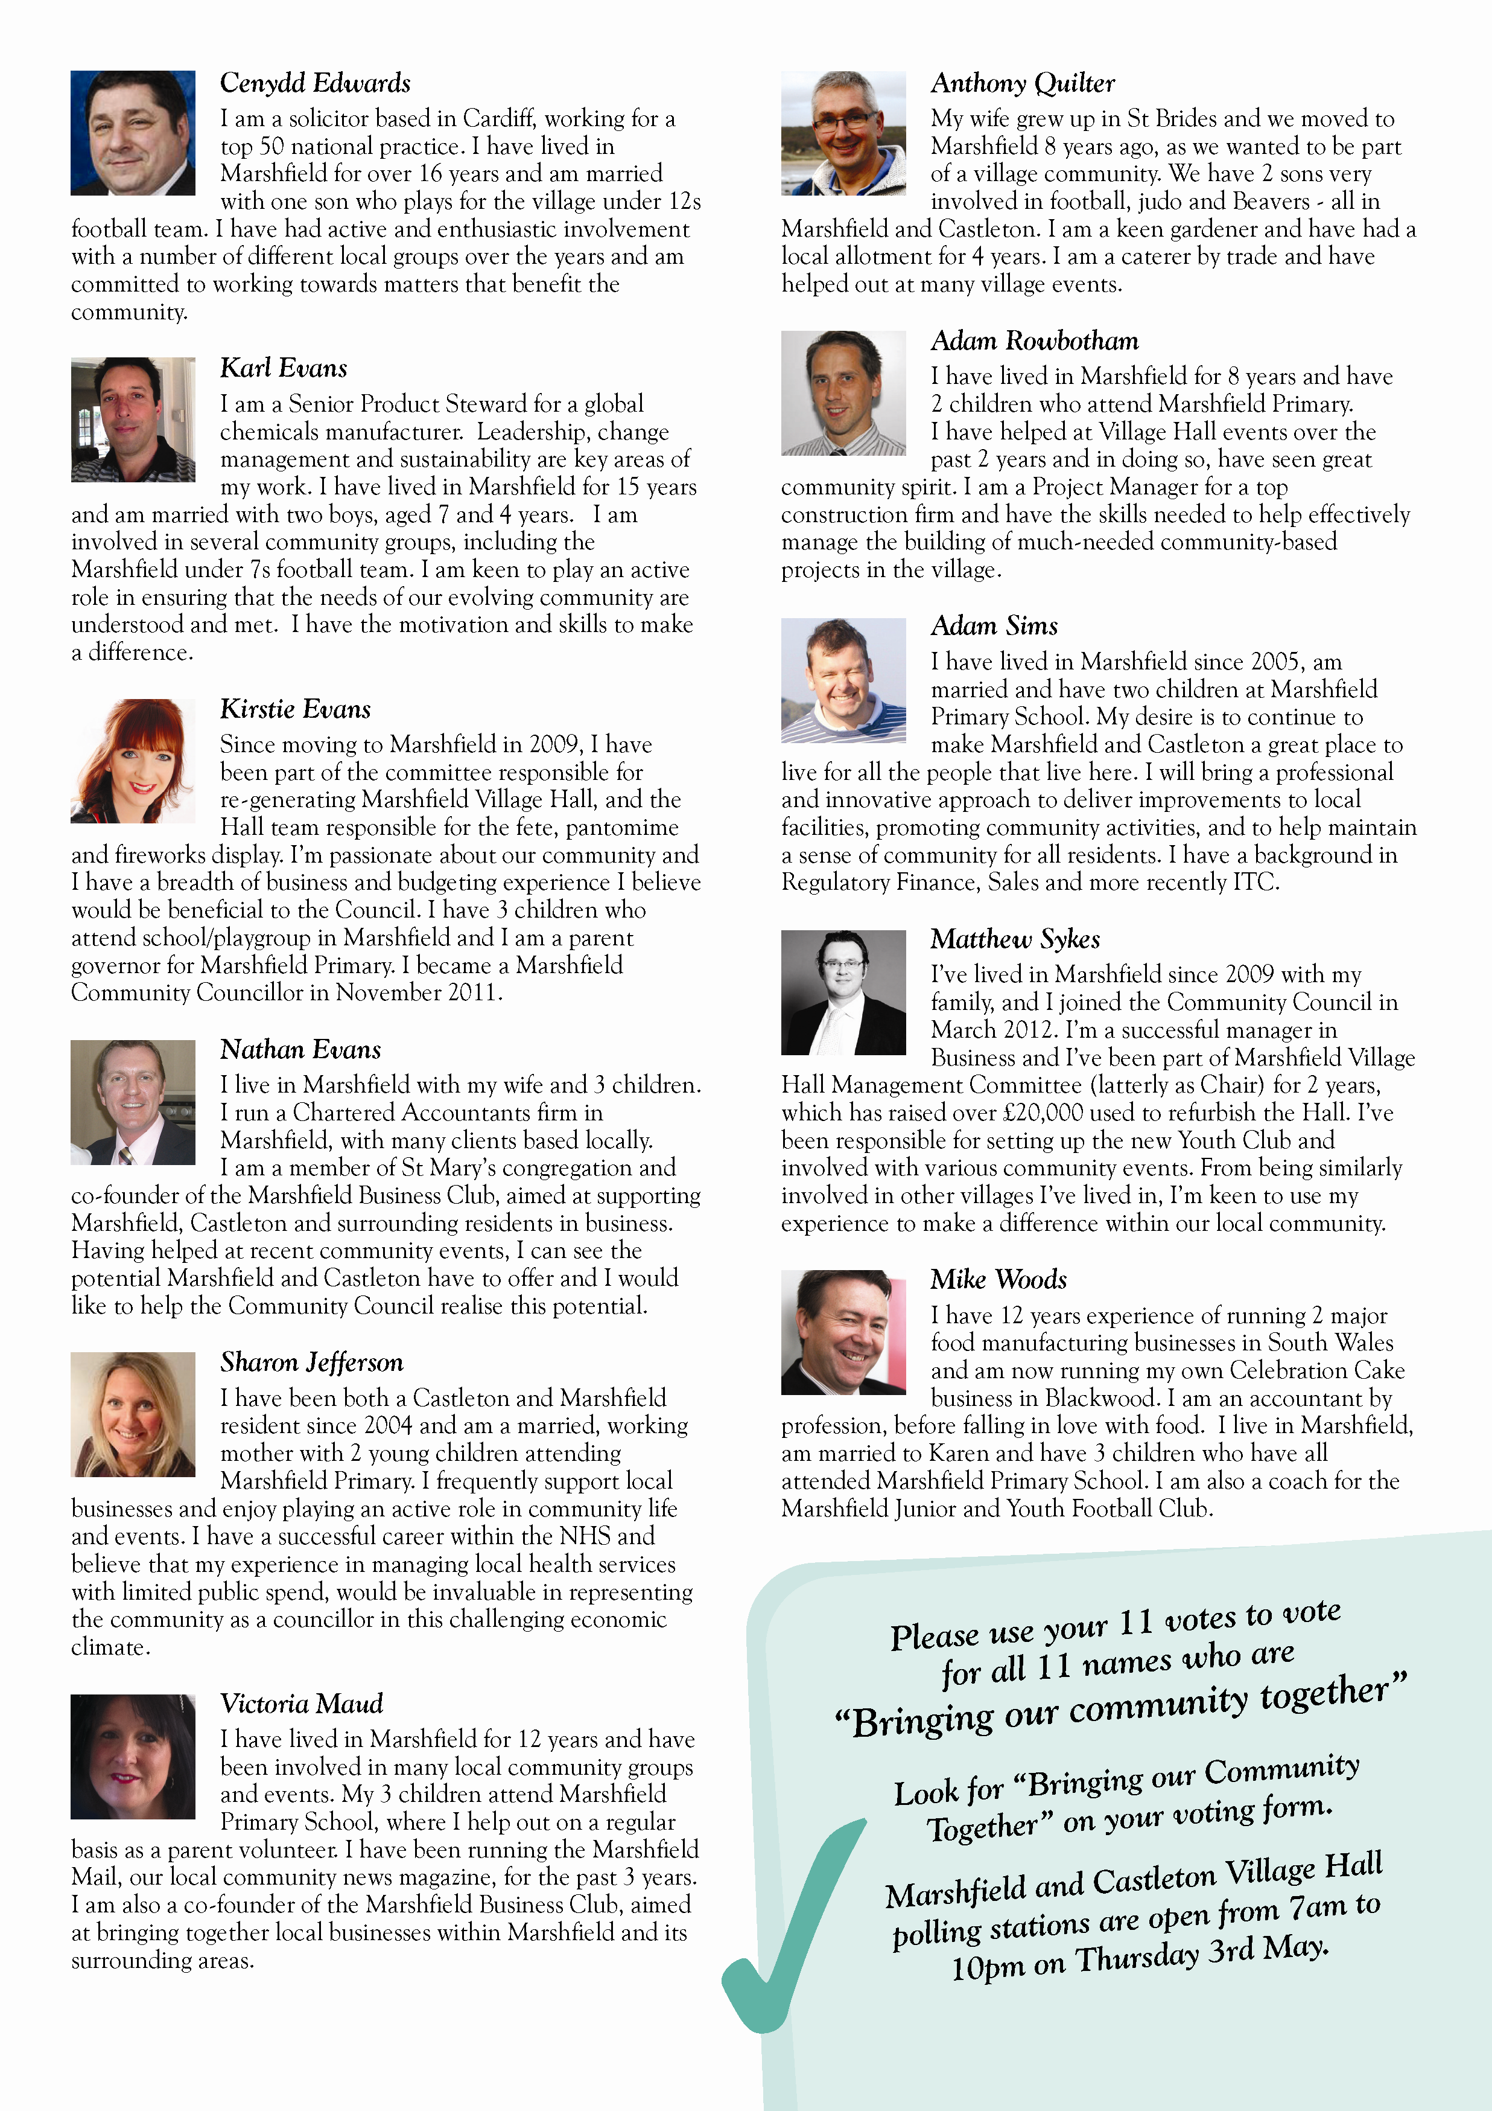
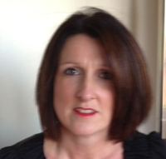
Community Council Members

Slide 4
Our Vision
To bring our community together

Slide 5
How will we do this?
We will build relationships with Marshfield and Castleton community groups and stakeholders.
Understand their needs, aims and concerns.
We will use this information to set our agenda:-
  (i) to deliver benefits that improve community life.
  (ii) to represent the best interests of our community to relevant public bodies.

Slide 6
Priorities
Maintain, enrich and protect our community.
Support worthy community projects.
Deliver the leisure project.
Raise profile of MCC via proactive communication.

Slide 7
Topics for Tonight’s Consultation
Leisure project
Community issues

Slide 8
Leisure Project - Overview
Budget £100k, up to ~150k, if additional funding secured.
  Section 106 money given for previous residential development in the area.
Possible locations include, but not limited to:-
  Marshfield Village Hall
  Existing play areas
  Residential areas, such as The Meadows and Mallards Reach
  Marshfield Primary School
  Public woodland areas
  And more……

Slide 9
Leisure Project - Milestones
Task | Milestone
Public Consultation – Input of ideas | 27th September, 2012
Deadline for survey responses | 26th October, 2012
Evaluation of options | Nov 2012 - Jan 2013
Public consultation on Shortlist - Likes, dislikes, preferences…. | February, 2013
Proposed Project(s) put to Marshfield Community Council for approval | March, 2013
Planning Application(s) Submitted | March, 2013
Tender Period | July, 2013
Commence Construction | September, 2013
Project Completion | November, 2013

Slide 10
Community Issues
Please tell us about
  What’s working
  What’s not working
  Your ideas to improve community life in general
  What you need from the Community Council

Slide 11
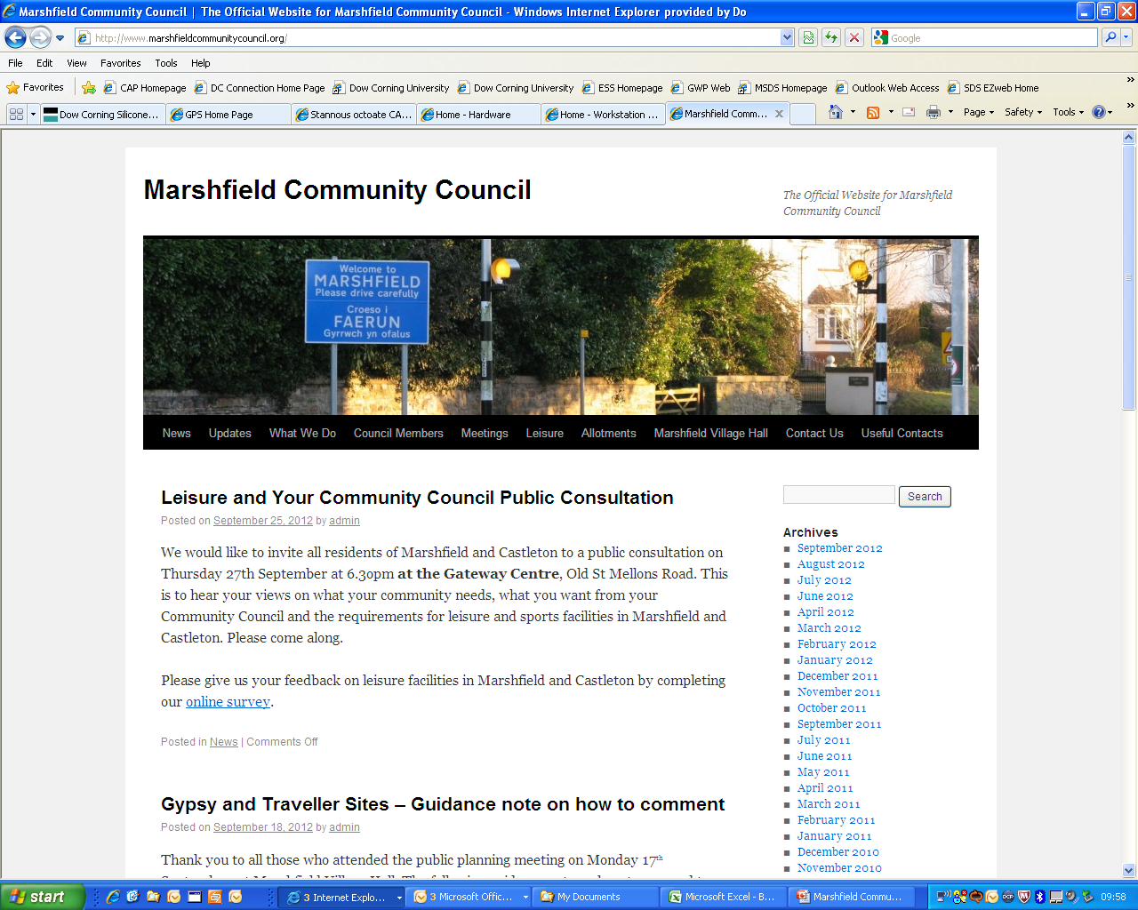
Please complete the on-line survey

Slide 12
Questions and Suggestions
  Leisure issues
  Community issues

Slide 13
Thank you!

